Slide 1

Data Engineering
Mid-term presentation
Group 9

Slide 2

Goal

Slide 3
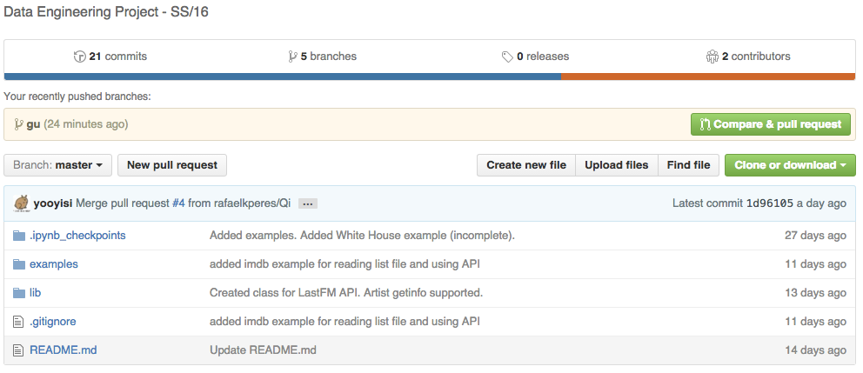

Slide 4
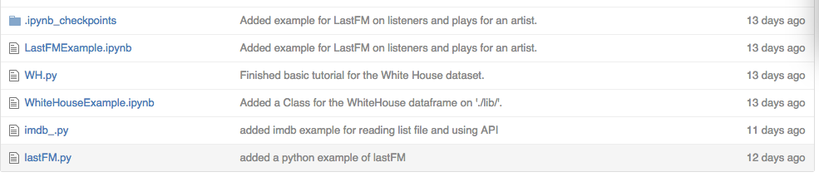
example

Slide 5

lib

Slide 6
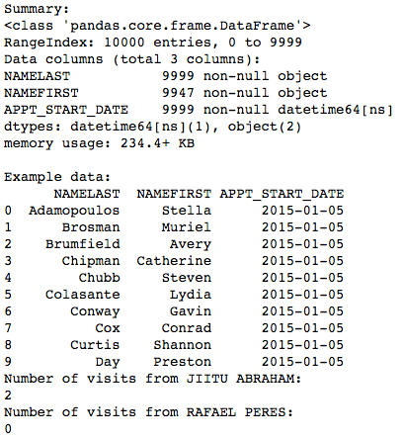
Example WH

Slide 7
Example IMDB

Slide 8
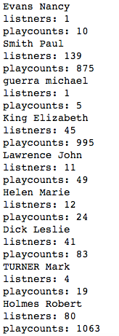
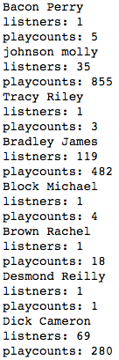
Problem 1
Find musicians that went to WH
Query 500 records from WH

